Slide 1
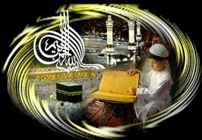
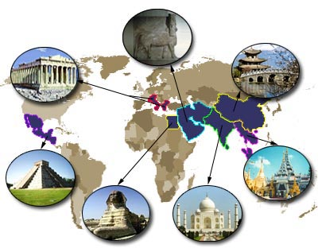
ISLAMIC CONTRIBUTION TO HUMAN CIVILIZATION
:

Slide 2
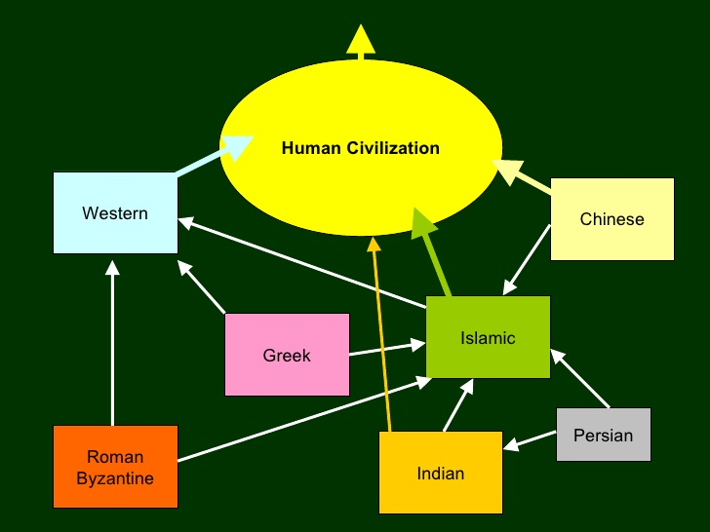
HUMAN CIVILIZATION

Slide 3
CIVILIZATION
An advanced state of intellectual, cultural, and material development in human society, marked by progress in the arts and sciences, the extensive use of record-keeping, including writing, and the appearance of complex political and social institutions.The type of culture and society developed by a particular nation or region.

Slide 4
POSTULATES OF CIVILIZATION
=> Large urban centers
=> occupations
=> Primary producers of food
=> Monumental architecture => System for recording information
=> Development of practical sciences
=> Monumental art
=> Regular importation of raw materials => State religion/ideology
=> Persistent state structures

Slide 5
ISLAMIC CONTRIBUTION TO SCIENCE MUSLIM SCIENTISTS
The traditional Islamic institutions of learning produced numerous great theologians, philosophers, scholars and scientists. Muslim scientists’ contributions in various fields of knowledge indicate the level of scholarship base developed among he Muslims one thousand years ago. Only few are being mentioned here:

Slide 6
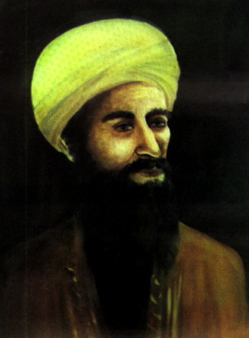
JABIR BIN HAYAN
Jabir bin Hayman known as the “father of chemistry.” He studied most branches of learning, including medicine. After the ‘Abbasids defeated the Umayyad, Jabir became a court physician to the ‘Abbasid caliph Haran are-Rashid. Jabir was a close friend of the sixth Shiite imam, Ja 'far bin Muhammad, whom he gave credit for many of his scientific ideas.

Slide 7
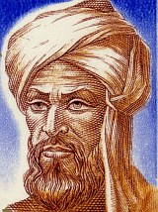
AL KHUWARZIMI
Al-Khwarizmi was a researcher of mathematics, algorithm, algebra, calculus, astronomy & geography. He compiled astronomical tables, introduced Indian numerals (which became Arabic numerals), formulated the oldest known trigonometric tables, and prepared a geographic encyclopedia in cooperation with 69 other scholars.

Slide 8
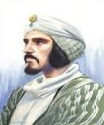
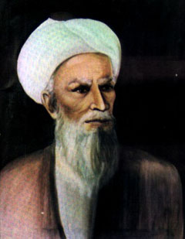
AL-KINDI & AL-RAZI
=> Bin Shaq Al-Kind: He was an intellectual of philosophy, physics, optics, medicine, mathematics & metallurgy. => Al-Raze was a physical and scientist of medicine, ophthalmology, smallpox, chemistry & astronomy. His two most significant medical works are the Kitbag al-Mansur, which became well known in the West in Gerard of Cremona’s 12th-century Latin translation; and ‘Kitbag al-haw’, the “Comprehensive Book”. Among his numerous minor medical treatises is the famed Treatise on the Small Pox and Messes, which was translated into Latin later.

Slide 9
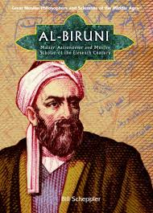
AL-BIRUNI
Abu Radian Al-Bruin was a Persian scholar and scientist, one of the most learned men of his age and an outstanding intellectual figure. Al-Biruni’s most famous works are Athar al-baqiyah (Chronology of Ancient Nations); at-Tafhim (“Elements of Astrology”); al-Qanun al-Mas’udi (“The Mas’udi Canon”), a major work on astronomy, which he dedicated to Sultan Mas’ud of Ghazna; Ta’rikh al-Hind (“A History of India”); and Kitab as-Saydalah, a treatise on drugs used in medicine. In his works on astronomy, he discussed with approval the theory of the Earth’s rotation on its axis and made accurate calculations of latitude and longitude. He was the first one to determine the circumference earth. In his works on geography, he advanced the daring view that the valley of the Indus had once been a sea basin.

Slide 10
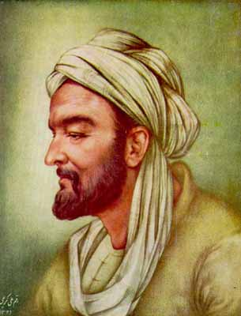
IBN-SINA
Ibn Sina was a scientist of medicine, philosophy, mathematics & astronomy. He was particularly noted for his contributions in the fields of Aristotelian philosophy and medicine. He composed the Kitab ash-shifa` (“Book of Healing”), a vast philosophical and scientific encyclopedia, and the Canon of Medicine, which is among the most famous books in the history of medicine.

Slide 11
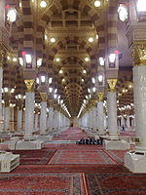
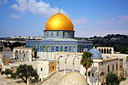

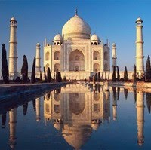
ISLAMIC CONTRIBUTION TO ARCHETACTURE
Islamic architecture encompasses a wide range of both secular and religious styles from the foundation of Islam to the present day, influencing the design and construction of buildings and structures in Islamic culture. The principal Islamic architectural types are: the Mosque, the Tomb, the Palace and the Fort. From these four types, the vocabulary of Islamic architecture is derived and used for buildings of less importance such as public baths, fountains, educational institutions, universities and domestic architecture.

Slide 12
CONTRIBUTION TO ART
Islamic art encompasses the visual arts produced from the 7th century onwards by people (not necessarily Muslim) who lived within the territory that was inhabited by or ruled by culturally Islamic populations. It is thus covers many lands and various peoples over some 1400 years; it is not art specifically of a religion, or of a time, or of a place, or of a single medium like painting. The huge field of Islamic architecture is the subject of a separate article, leaving fields as varied as calligraphy, painting, glass, ceramics, and tex.

Slide 13
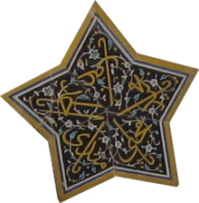
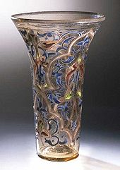
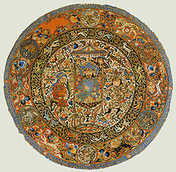
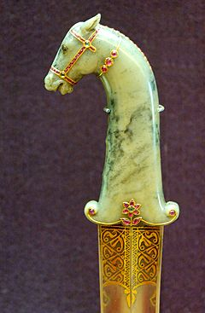
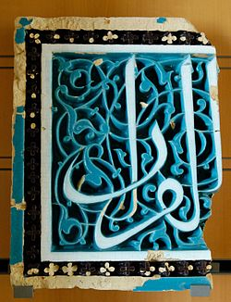
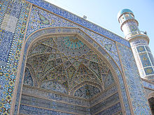
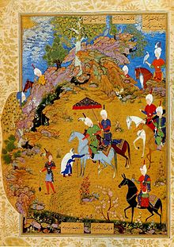
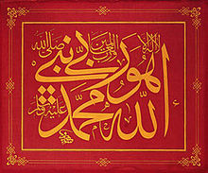
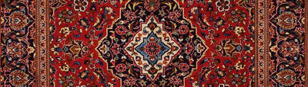
ISLAMIC ART

Slide 14
STATE RELIGION/IDEOLOGY
A state religion (also called an official religion) is a religious body or creed officially endorsed by the state. A state with an official religion, while not secular, is not necessarily a theocracy. The degree and nature of state backing for denomination or creed designated as a state religion can vary. It can range from mere endorsement and financial support, with freedom for other faiths to practice, to prohibiting any competing religious body from operating and to persecuting the followers of other sects. Islam contributed widely for religious tolerance, brotherhood, welfare for humanity and inter action among different religions. Which can be seen from the different acts of Prophet Muhammad s.a.w.w.

Slide 15
ISLAMIC FOODS FOR CIVILIZATION
Foods are the basic aspect of any civilization. Islam introduced some new trends in foods for society, which were based on the concept of HALAAL and HARAAM. Halaal foods are according to human need and these are hygienic and bene
Rice, Pasta, Any grain product, All vegetables and fruit,All vegetables and fruits or vegetable oils, Milk, Meat and poultry slaughtered according to Islamic dietary law ("Zabihah), Seafood, Eggs, Nuts, seeds, Peanut Butter, Fruit juice, punch, tea and coffee, Fats and oils, butter, vegetable oils and some salad dressings, Coconut milk, jam, pickles, spices, Honey, sugar, syrup, bean syrup, Any Zabihah meat or alternative dish, pizza, pasta or rice prepared without Haram foods and ingredients
& Soups, sauces any made without Haram foods and ingredients.

Slide 16

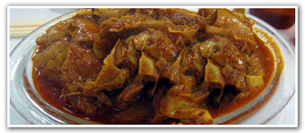
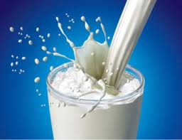
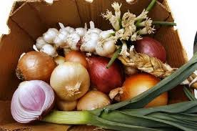
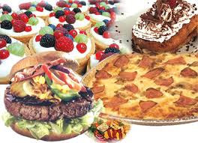
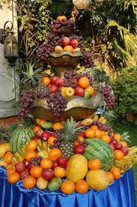
ISLAMIC FOODS

Slide 17
CONCLUSION
Islam played an important and historical role in advancing world civilization. Muslims carried out the civilization torch during dark ages and prevent and advanced the treasure of culture and knowledge for humanity. In all aspects of our lives including our homes, offices, schools, universities, religion, philosophy, science, art, architecture etc we are concerned to Islamic creativity..

Slide 18


